Slide 1
Cause of deaths
INTERNSHIP 33
BY:-ANJALI WADHWANI

Slide 2
AGENDA
Introduction​
Top 3 countries and their death tolls
Comparison between top three countries
China v/s India
Countries with least number of deaths

Slide 3
Introduction
A straightforward way to assess the health status of a population is to focus on mortality – or concepts like child mortality or life expectancy, which are based on mortality estimates. A focus on mortality, however, does not take into account that the burden of diseases is not only that they kill people, but that they cause suffering to people who live with them. Assessing health outcomes by both mortality and morbidity (the prevalent diseases) provides a more encompassing view on health outcomes. This is the topic of this entry. The sum of mortality and morbidity is referred to as the ‘burden of disease’ and can be measured by a metric called ‘Disability Adjusted Life Years‘ (DALYs). DALYs are measuring lost health and are a standardized metric that allow for direct comparisons of disease burdens of different diseases across countries, between different populations, and over time. Conceptually, one DALY is the equivalent of losing one year in good health because of either premature death or disease or disability. One DALY represents one lost year of healthy life. The first ‘Global Burden of Disease’ (GBD) was GBD 1990 and the DALY metric was prominently featured in the World Bank’s 1993 World Development Report. Today it is published by both the researchers at the Institute of Health Metrics and Evaluation (IHME) and the ‘Disease Burden Unit’ at the World Health Organization (WHO), which was created in 1998. The IHME continues the work that was started in the early 1990s and publishes the Global Burden of Disease study.

Slide 4
Top 3 countries and their death tolls

Slide 5
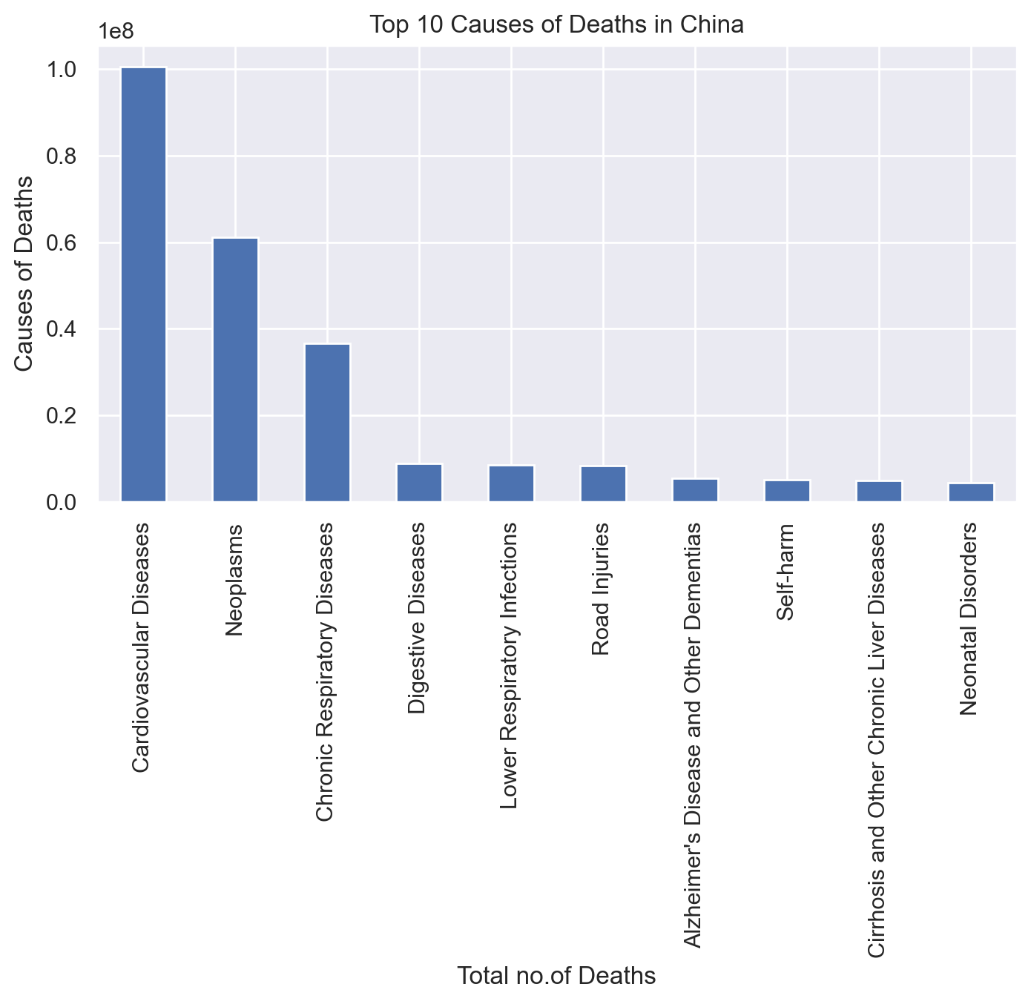
China being the top n the ladder of population in the world and thus it is top on the ladder of death tolls table.
Most of the deaths caused in China are due to cardiac arrest followed by neoplasms and respiratory diseases.

Slide 6
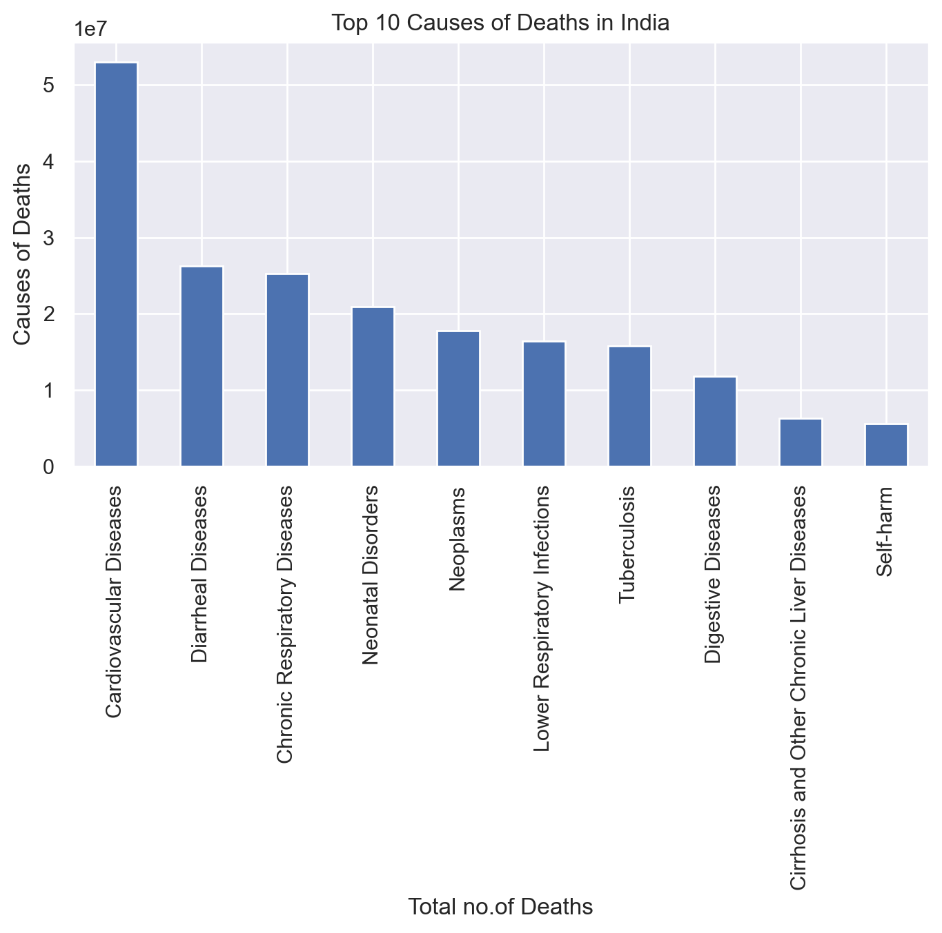
Second being India in the ladder.
Most od the deaths in India are caused due to cardiac arrest followed by diarrheal and respiratory diseases.

Slide 7
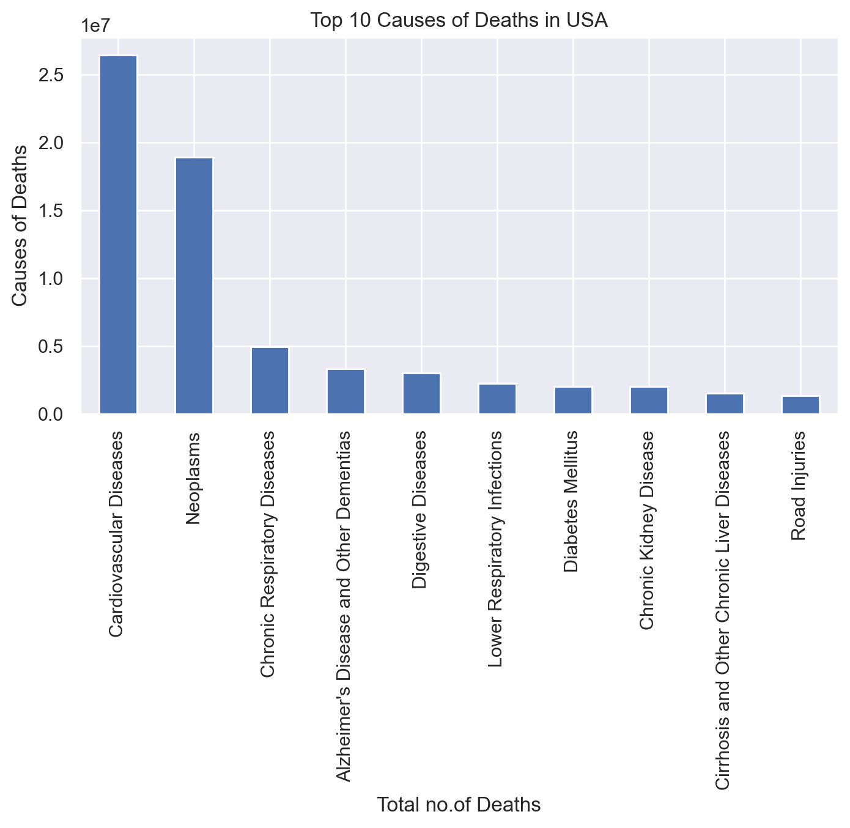
USA is third on the ladder and the most number of deaths caused in USA are by cardiac arrest followed by neoplasms.

Slide 8
The inference drawn from the above graphs that most of the deaths in the world are caused due cardiovascular and the other common reason of deaths is chromic respiratory diseases.

Slide 9
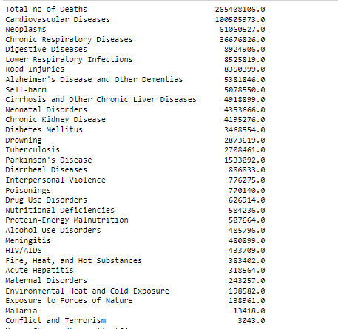
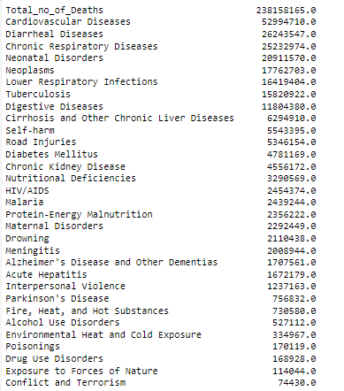
China v/s india
Both countries are facing pressure of cardiac diseases.
The second most common disease in both countries is chronic respiratory diseases.
China has curbed malaria deaths and India still has highest toll in it.
Road injuries are more in number in China than India.

Slide 10
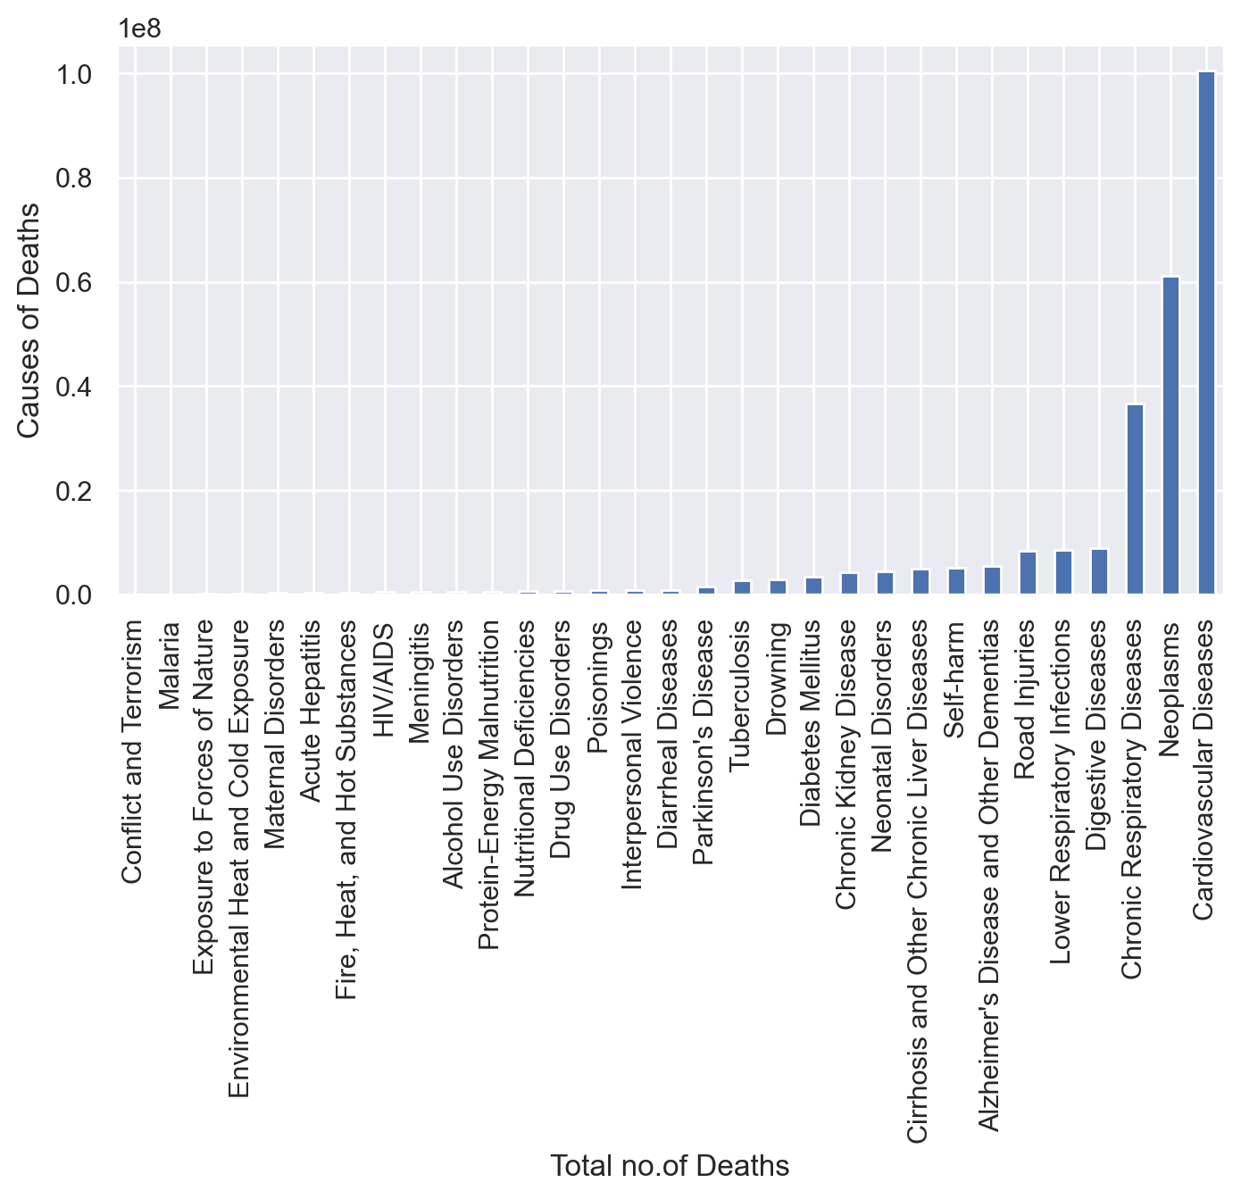
Tokleau is the country with least number of deaths followed by Niue
And Nauru.
These on the reason of deaths on Tokleau which clearly highlights that most of the deaths are caused due to cardiovascular diseases.

Slide 11
Cardiovascular diseases (CVDs) are the leading cause of death globally, taking an estimated 17.9 million lives each year. CVDs are a group of disorders of the heart and blood vessels and include coronary heart disease, cerebrovascular disease, rheumatic heart disease and other conditions. More than four out of five CVD deaths are due to heart attacks and strokes, and one third of these deaths occur prematurely in people under 70 years of age.
The most important behavioural risk factors of heart disease and stroke are unhealthy diet, physical inactivity, tobacco use and harmful use of alcohol. The effects of behavioural risk factors may show up in individuals as raised blood pressure, raised blood glucose, raised blood lipids, and overweight and obesity. These “intermediate risks factors” can be measured in primary care facilities and indicate an increased risk of heart attack, stroke, heart failure and other complications

Slide 12
THANK YOU

